Slide 1
N-ary Tree Tutorial and Code Review:
N-ary Tree creation
N-ary Tree node insertion
N-ary Tree node verification
N-ary Tree node freeing
github path for files: https://github.com/johndspence/n_trees.git
files:
ntree_insert.c, path_exists.c, and ntree_free.c Files should be compiled on Ubuntu 14.04 LTS, using gcc (Ubuntu 4.8.4-2ubuntu1~14.04) 4.8.4
Holberton School
20160816
John Spence

Slide 2
Overview
This presentation demonstrates how to create an N-ary Tree/insert a new node, validate if a node exists, and finally “free” the N-ary Tree. “N tree” and “N-ary tree” are used interchangeably in this presentation.
The code was written in C, for ubuntu 14.04.
Source files are here: https://github.com/johndspence/n_trees.git
This presentation was given in the context of a code review for the Holberton School in San Francisco.
The tasks themselves were written by Alex Gautier: https://github.com/Mattrack

Slide 3
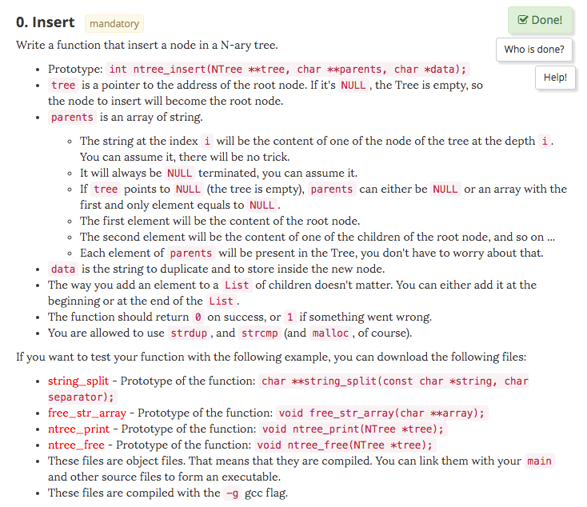
Task 0: N Tree Insert

Slide 4
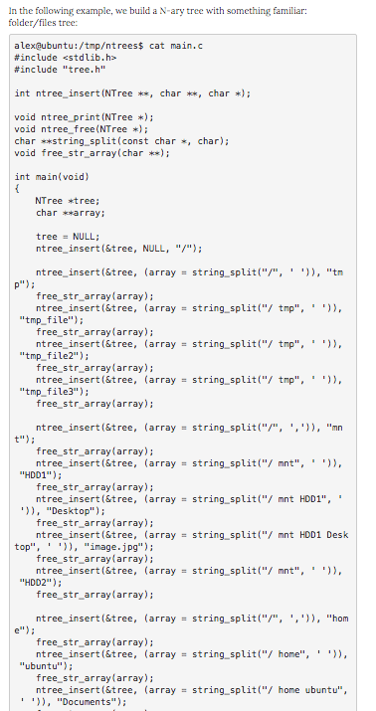
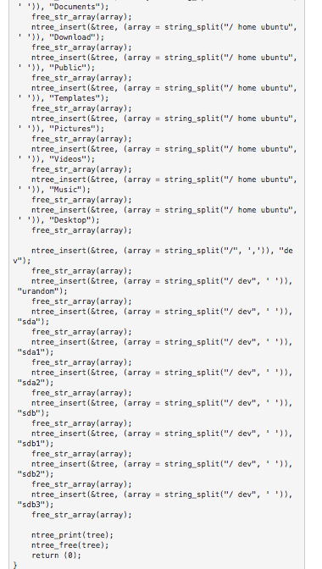
Task 0: N Tree Insert (example)

Slide 5
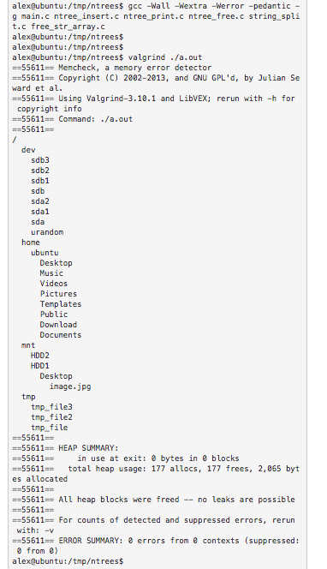
Task 0: N Tree Insert (Expected Output)

Slide 6
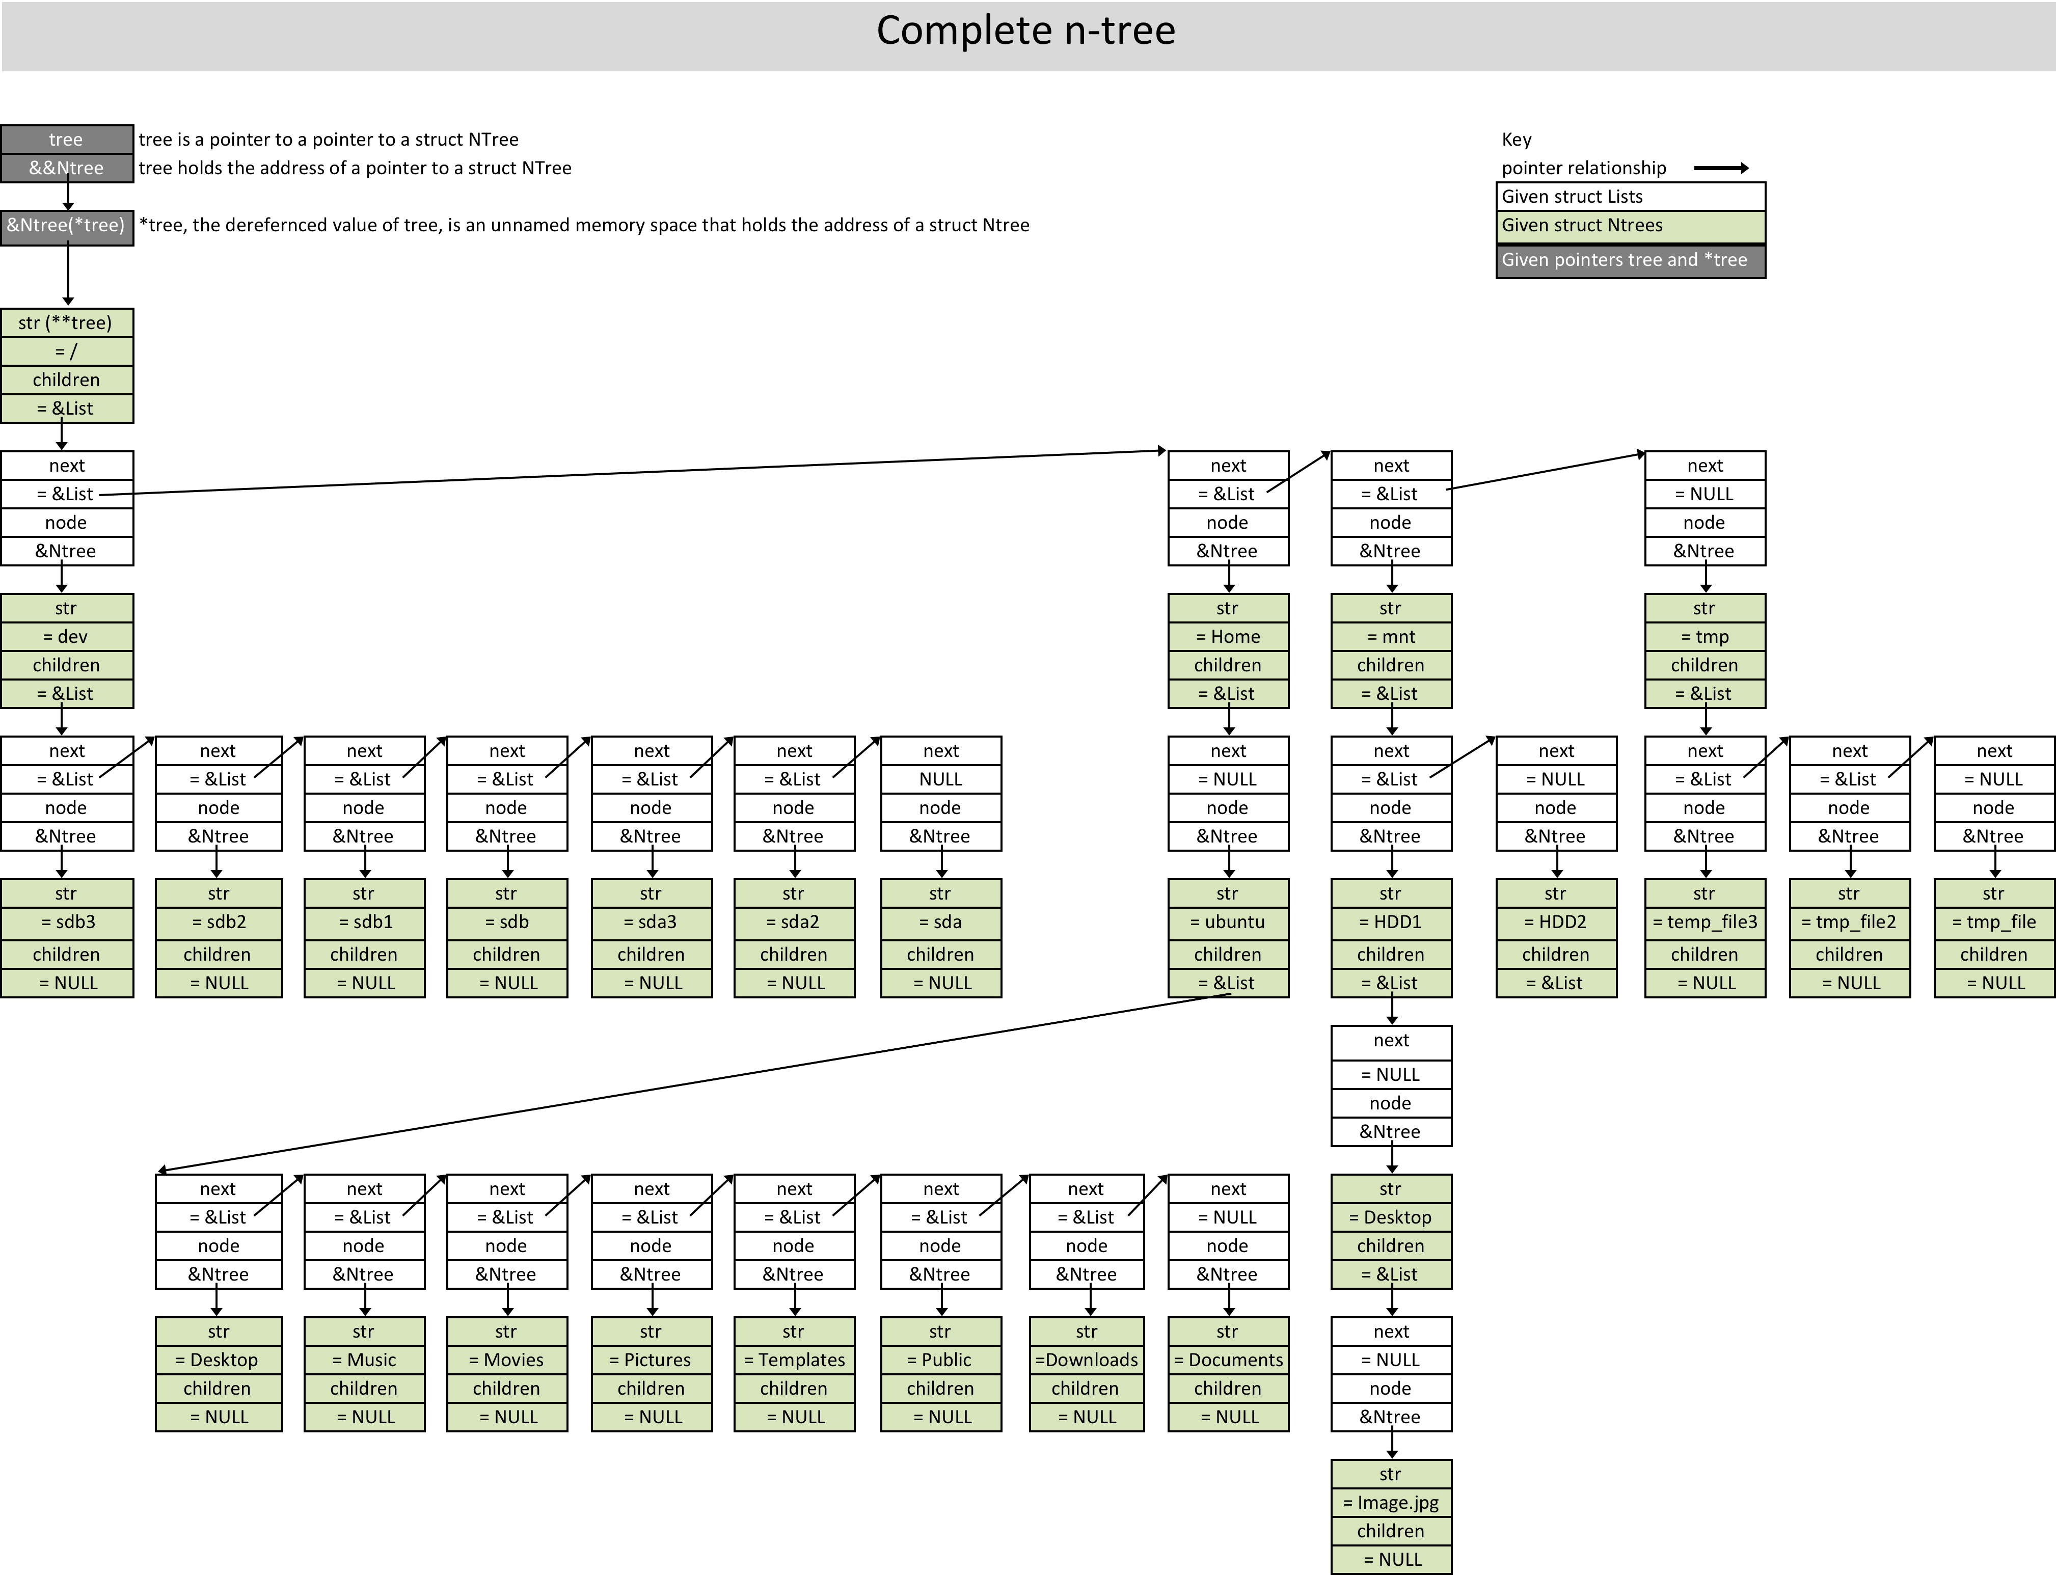
Complete n-tree

Slide 7
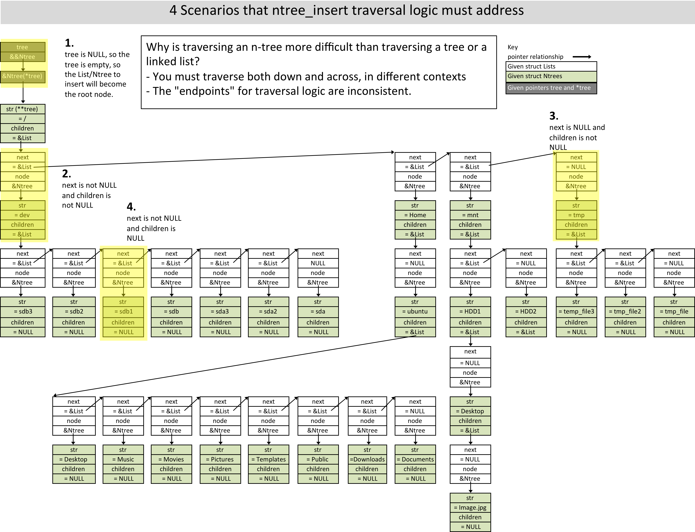
4 Scenarios that ntree_insert traversal logic must address

Slide 8
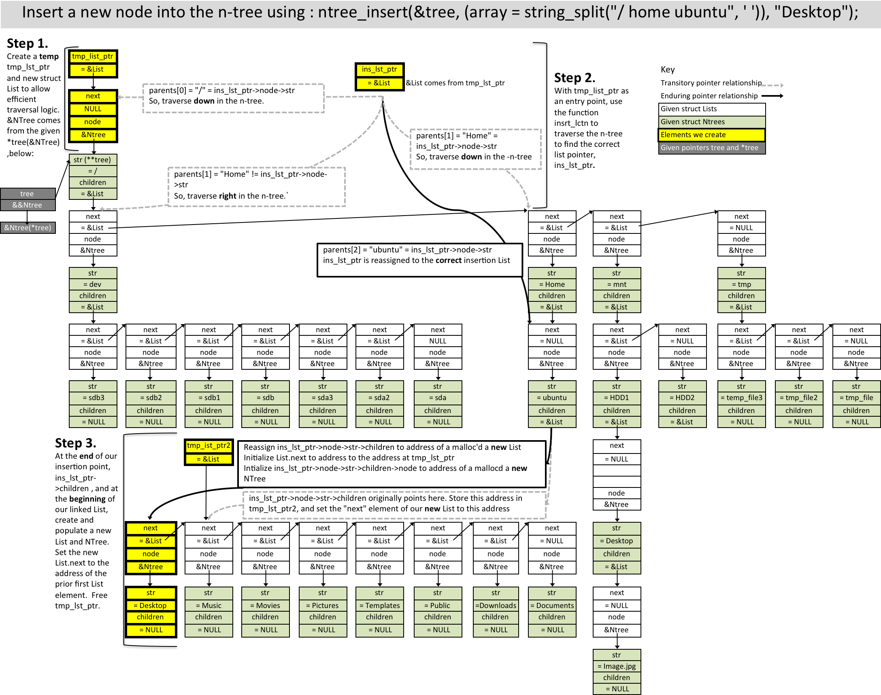
Insert a new node into the n-tree

Slide 9
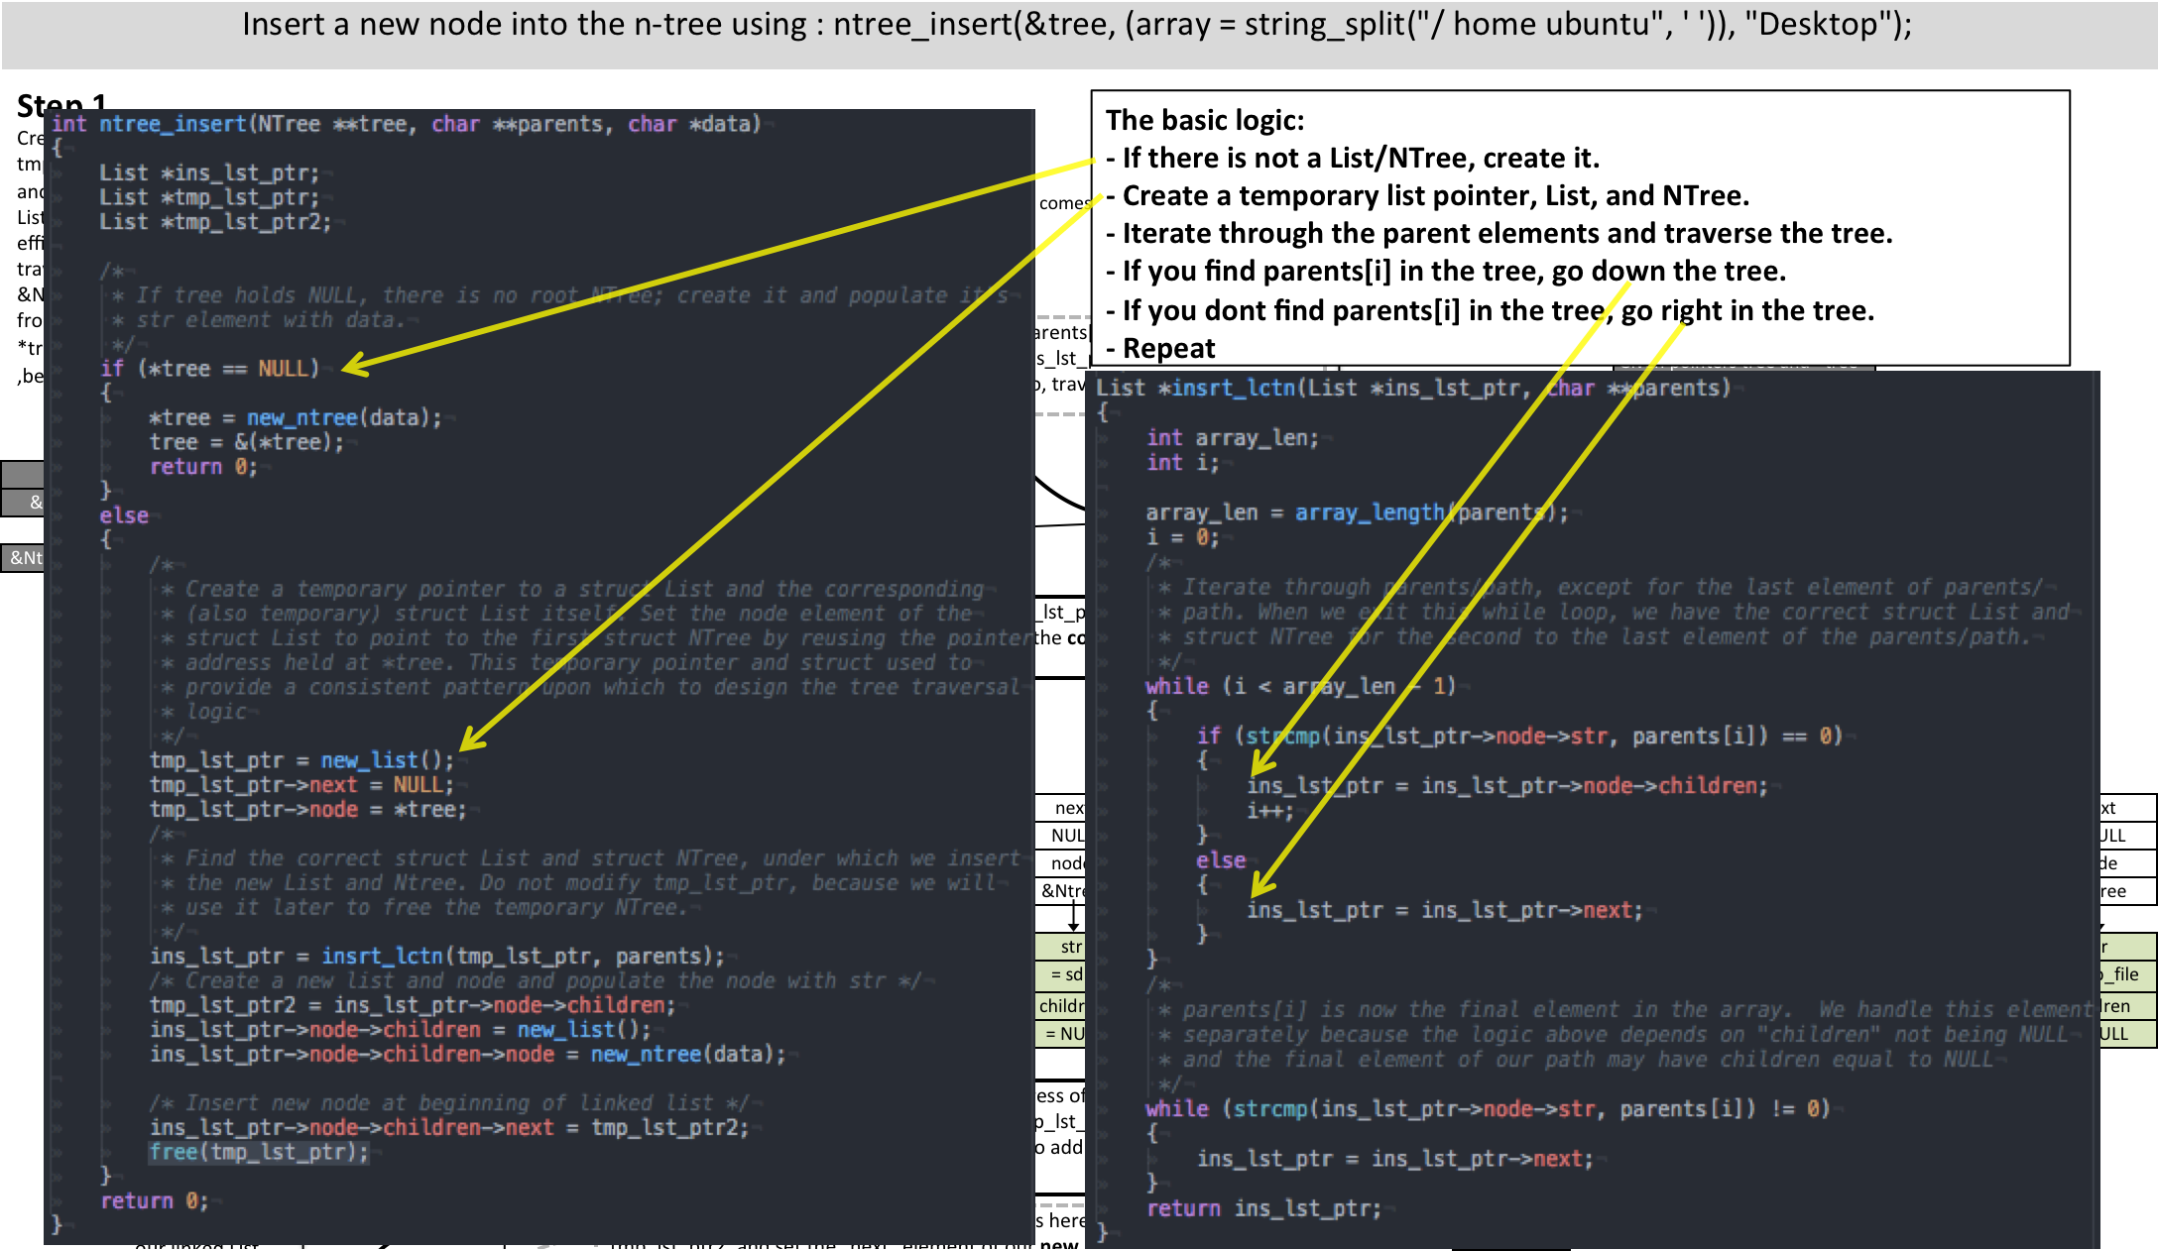
Insert a new node into the n-tree: code
Task 0: N Tree Insert (Code)

Slide 10
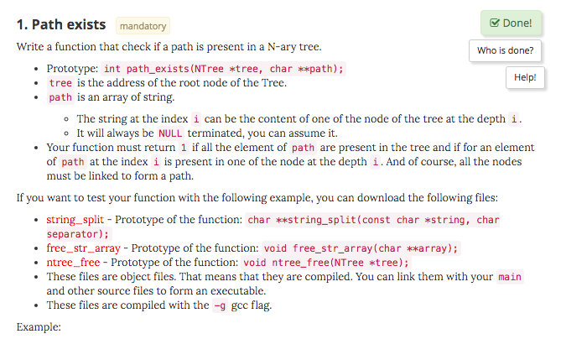
Task 1: Determine if an N Tree path/node exists

Slide 11
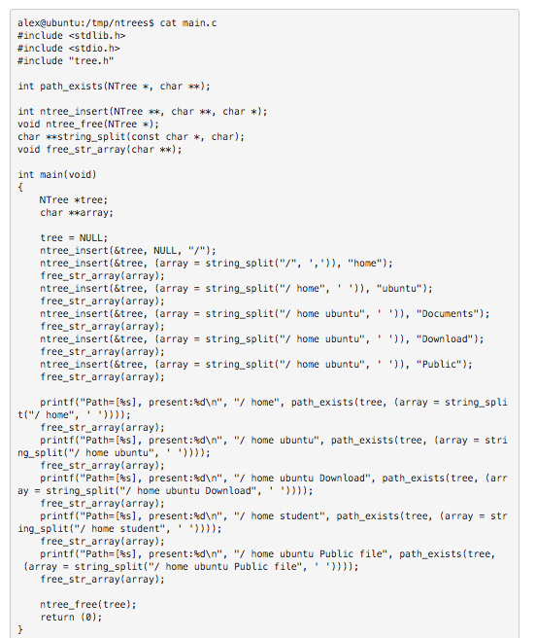
Task 1: Determine if an N Tree path/node exists (example)

Slide 12
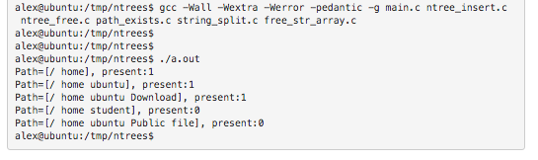
Task 1: Determine if an N Tree path/node exists (Expected Output)

Slide 13
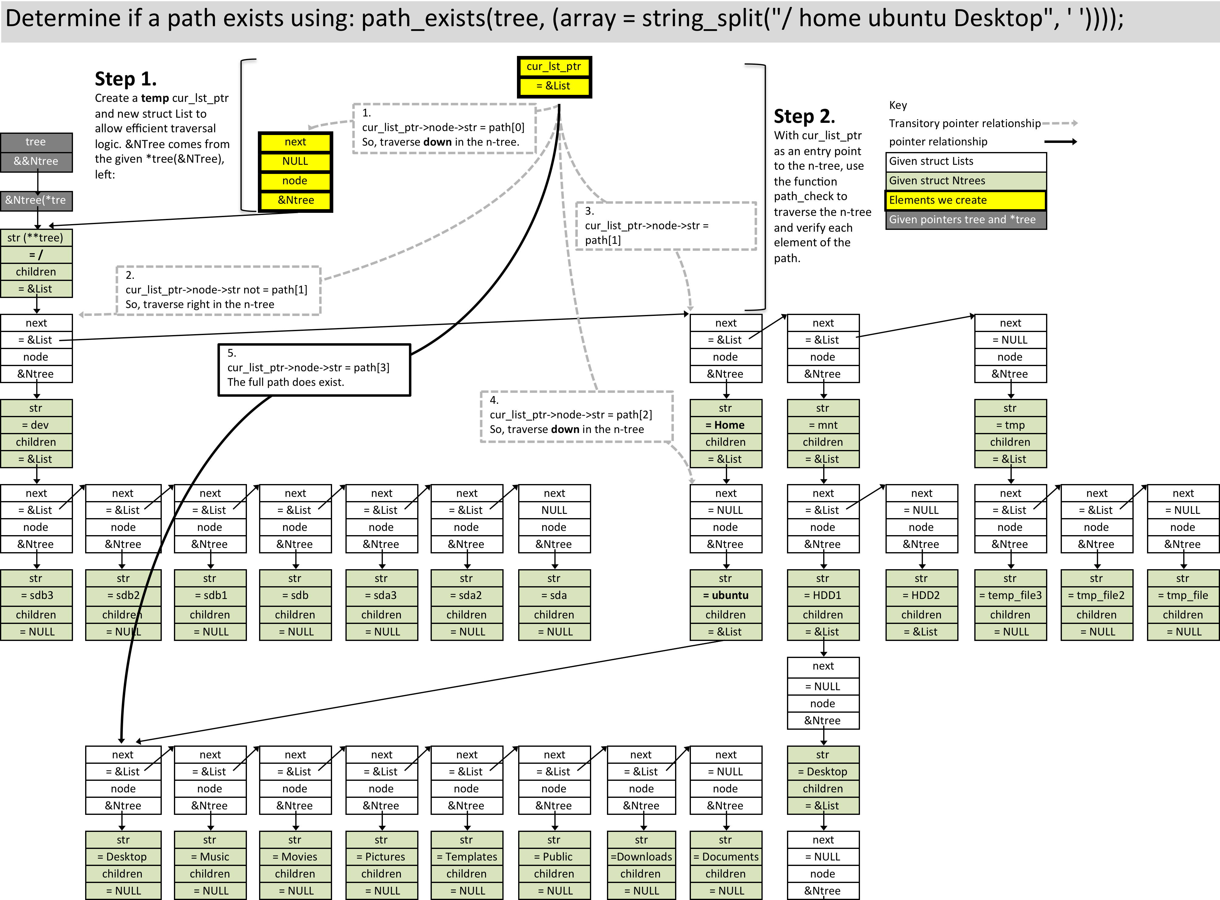
Determine if a path exists using: path_exists in an n-tree

Slide 14
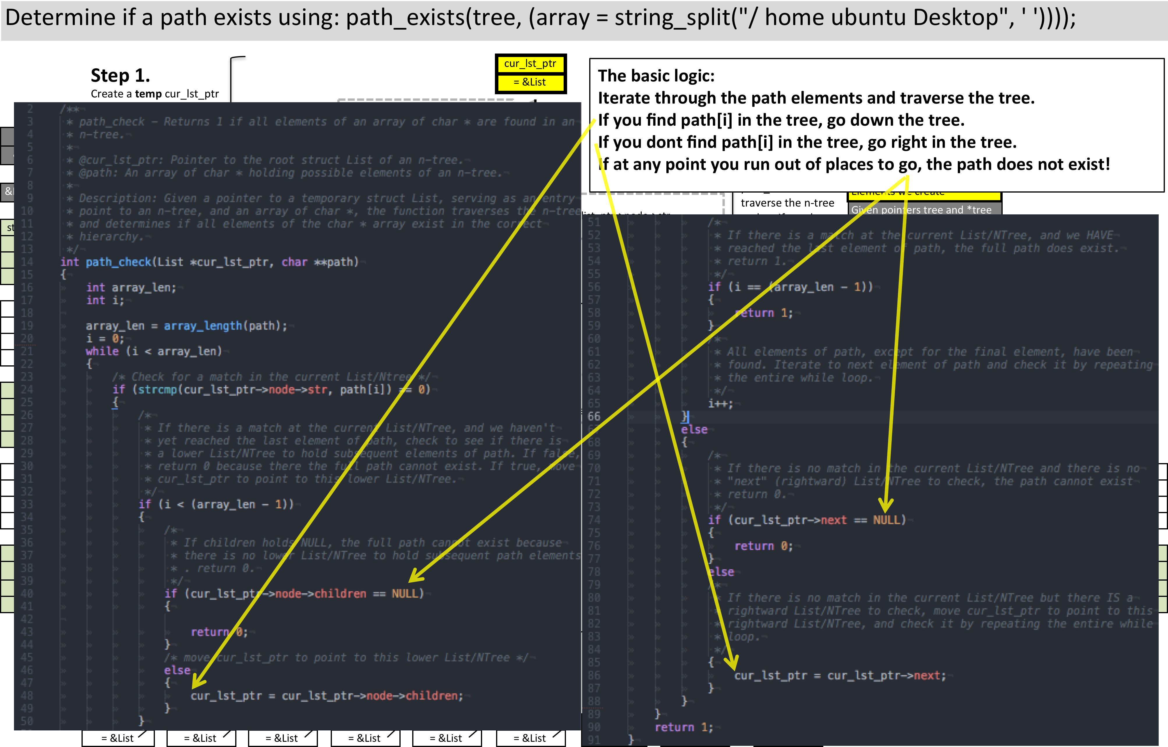
Determine if a path exists in a n-tree: code

Slide 15
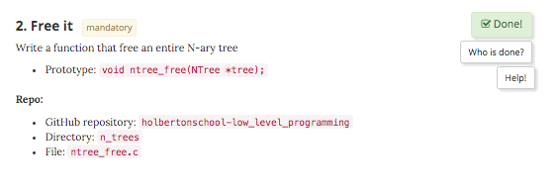
Task 2: Free an N Tree

Slide 16
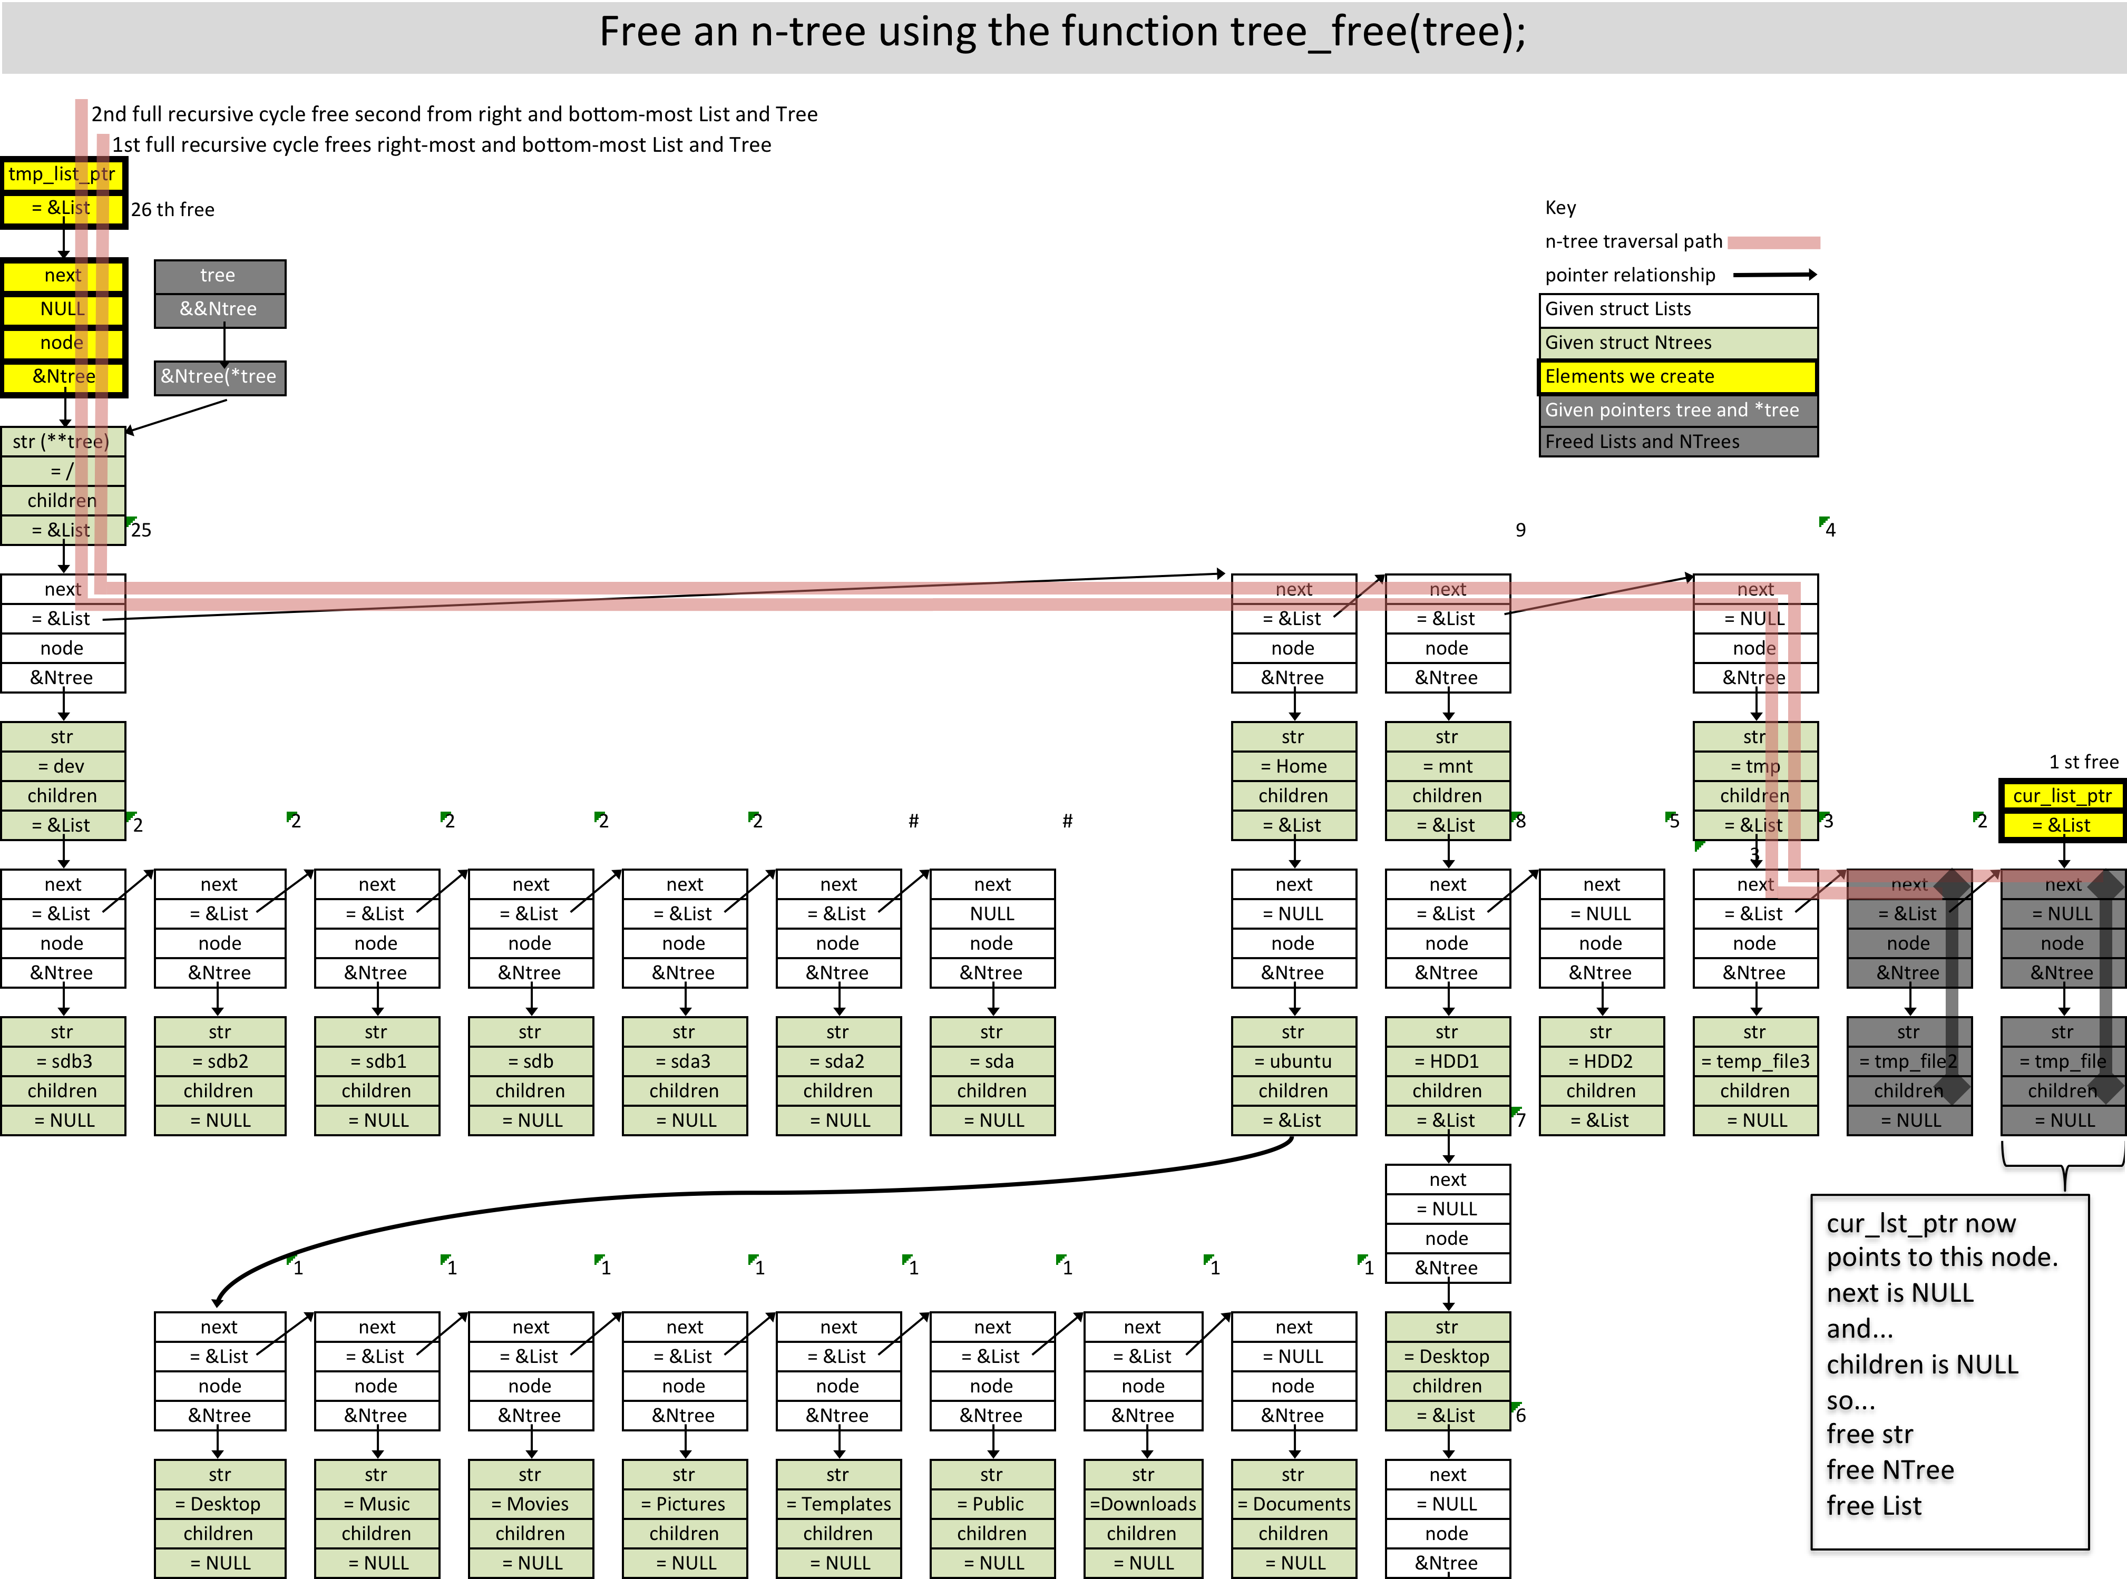
Free an n-tree

Slide 17
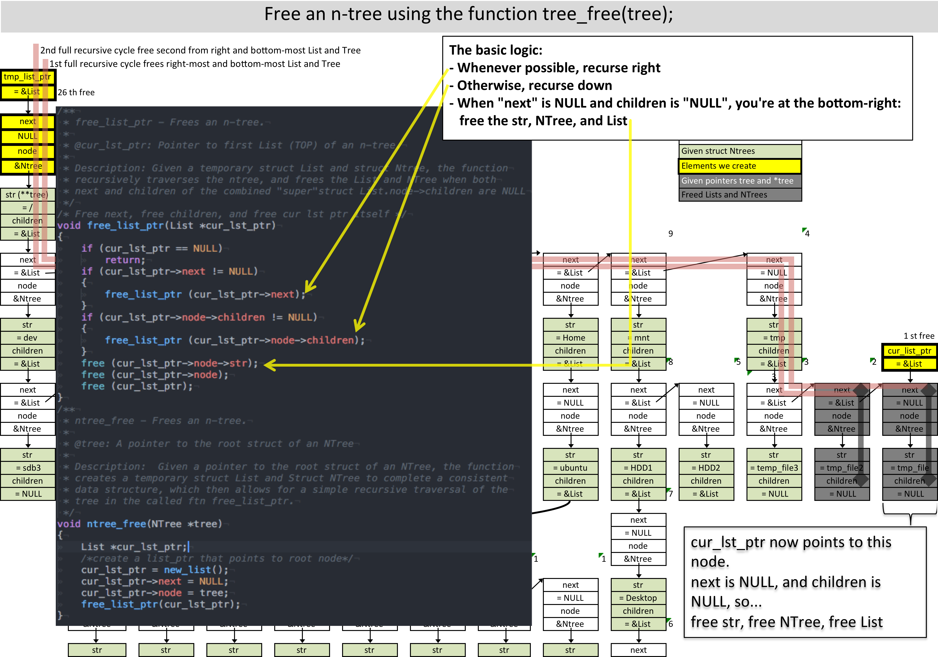
Free an n-tree: code

